Slide 1



UIET, PANJAB UNIVERSITY, CHANDIGARH GROUP PRESENTATION DATABASE MANAGEMENT SYSTEM 2021-22 DR. MAMTA JUNEJA ASSOCIATE PROFESSOR UIET CHANDIGARH, PU
PRESENTED ON : 29/11/2021

Slide 2


PRESENTED BY :-
UE203001 AASHI
UE203002 AASTHA
UE203028 ASMITA
UE203030 CHASHMEET SINGH
UE203031 CHIRAG CHANANA
UE203032 CHITRA JAIN
UE203043 GURSHAAN
UE203056 KETAN GUPTA
UNIVERSITY MANAGEMENT SYSTEM

Slide 3



About The Project
THE BASIC EDUCATION FOR EACH AND EVERY INDIVIDUAL IS THE NEED OF HOUR AND BEING IN A VERY VAST AND 2nd MOST POPULATED COUNTRY IN THE WORLD, EDUCATION SYSTEM HAS BECOME NEARLY IMMEASURABLE.
ALTHOUGH ITS DIFFICULT, YET, WE HAVE TO MANTAIN A FRIENDLY AND EASY GOING RECORD.
NOW WHAT’s A DATABSE?
By definition, databases are shared and integrated collection of logically related data stored together with
Controlled Redundancy (To link the data together)
Common and Controlled access technology
Independent of Application Programs along with CATALOG (Schema) which includes metadata (data about data)

Slide 4
NEED FOR THE SYTEM
UNIVERSITY MANAGEMENT SYSTEM deals with the maintenance of University data, records, instructions, and students information within the University. UMS is an automation system, which is used to store the information, students record, and information of courses.
It maintains all the details regarding the attendance and marks of the students. The project deals with the retrieval of information. It collects related information from all the departments of an organization, which are used to generate reports in various forms to measure Individual and overall performance of the students.
The objective of the project on University is to manage the details of Students, Classes, Instructors, and Courses. The project is totally built at administrative end and thus only the administrator is guaranteed the access.

Slide 5
Modules Built And Their Participation With Each Other
DEPARTMENT
STUDENT
STUDENT RECORD
TEACHING FACULTY
NON-TEACHING FACULTY
ADDRESS
SUBJECT TEACHING

Slide 6
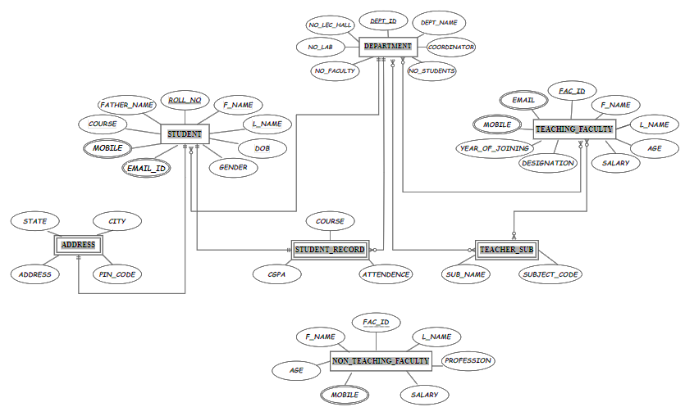
ER-MODEL

Slide 7

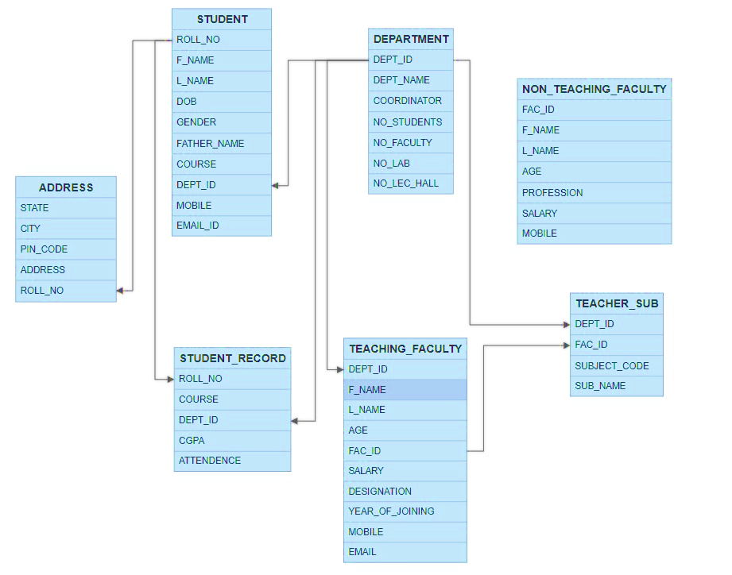
PRIMARY KEY
[PK]
FOREIGN KEY
[FK]

Slide 8
FEATURES OF PROJECT
DDL INSTRUCTIONS
DML INSTRUCTIONS
CONSTRAINT
FUNCTIONS
CURSORS
TRIGGERS
SUB-QUERIES
VIEWS
INDEXES
SEQUENCE
OPERATION
EXCEPTIONAL HANDLING
DCL INSTRUCTIONS
TCL INSTRUCTIONS
JOINS
PACKAGES

Slide 9

FUNCTIONALITY OF PROJECT

Slide 10
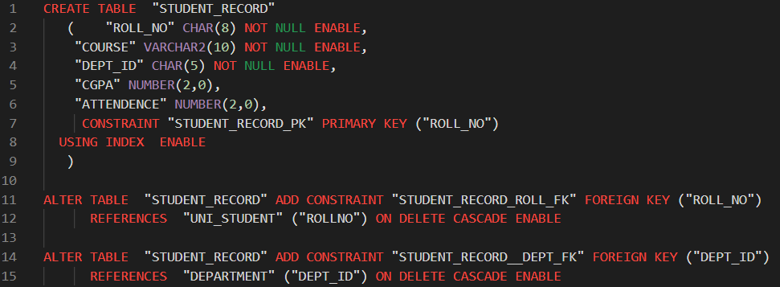
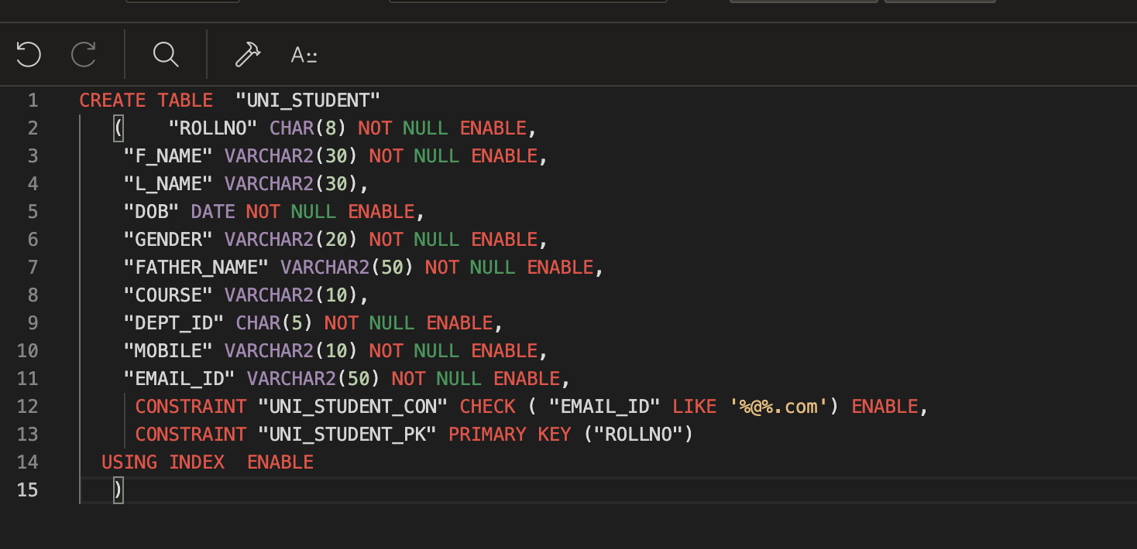
CREATE
This command is used to create a new table in the dataset
THIS IS UNIVERSITY STUDENTS TABLE,
IN WHICH ALL FIELDS ARE RELATED TO THE INFORMATION
OF STUDENTS STUDYING IN THE UNIVERSITY
THIS IS STUDENT RECORD TABLE, IN WHICH STUDENT’s ACEDAMIC DETAILS IS TO BE MAINTAINED FOR ALL WHO ENROLLED IN THE PARTICULAR DEPARTMENT

Slide 11
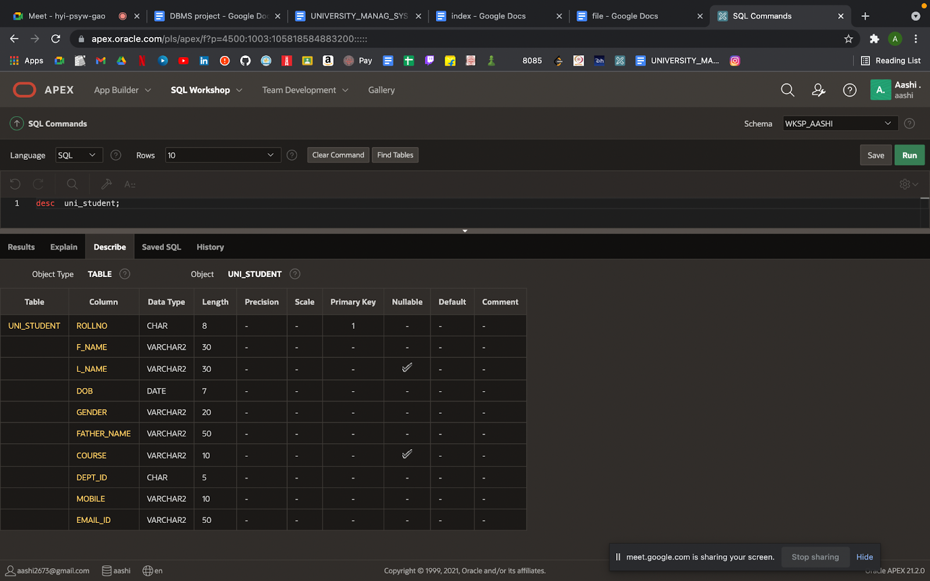
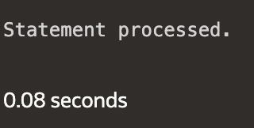
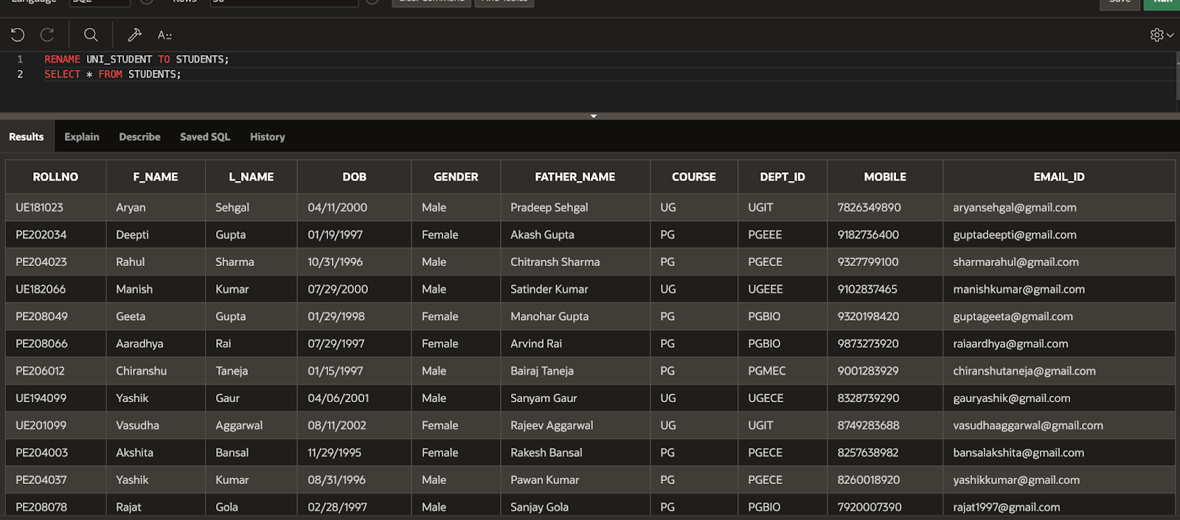
DESCRIBE This command is used to describe the structure of the table RENAME This command is used to rename an existing table

Slide 12

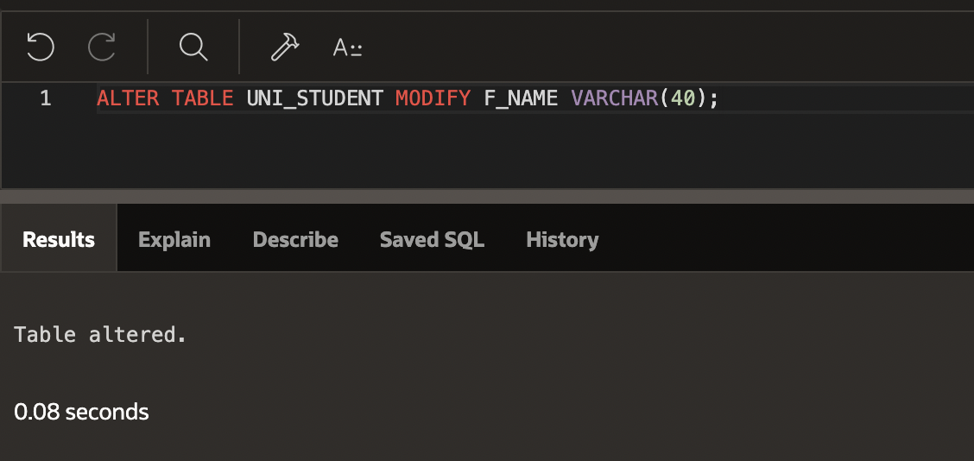
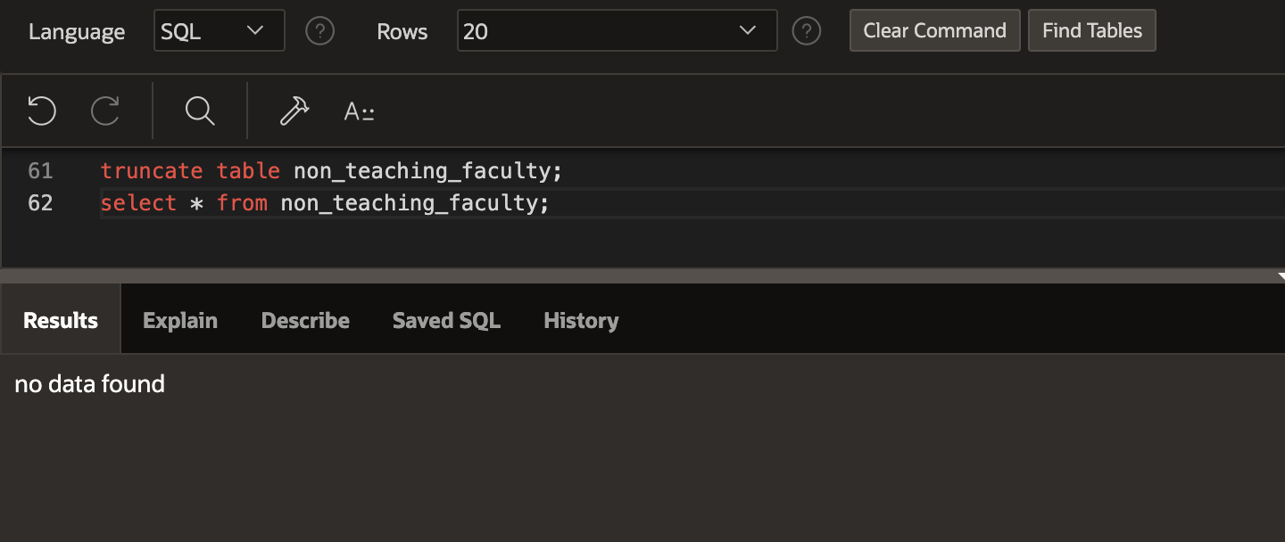
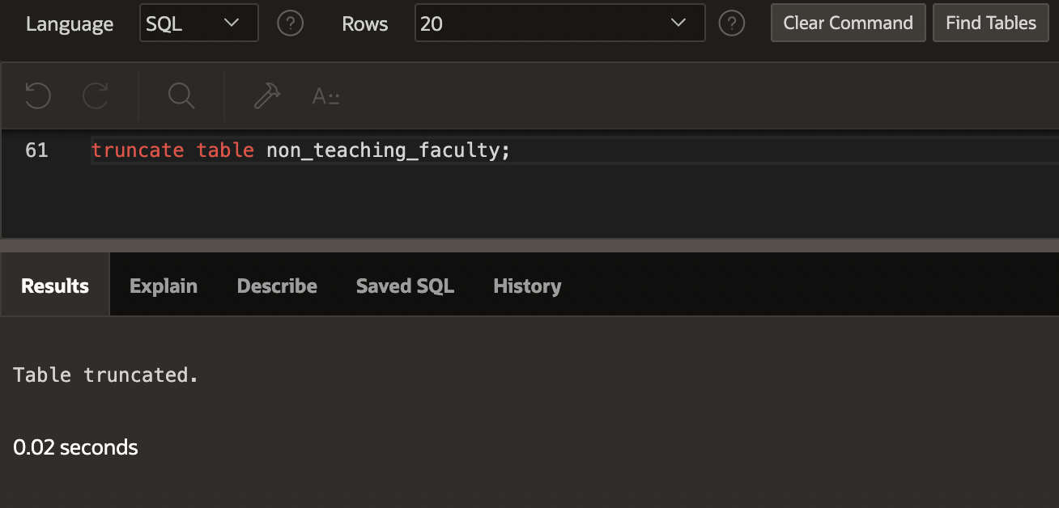
ALTER It is used to alter the structure of the database.
TRUNCATE
It is used to delete all the rows from the table and free the space containing the table.
DDL is Data Definition Language which is used to define data structures
-DDL INSTRUCTIONS
It basically defines the column (Attributes) of the table.

Slide 13

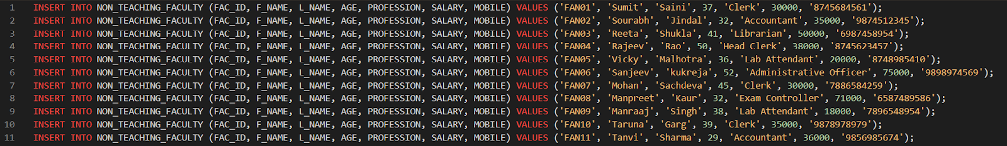
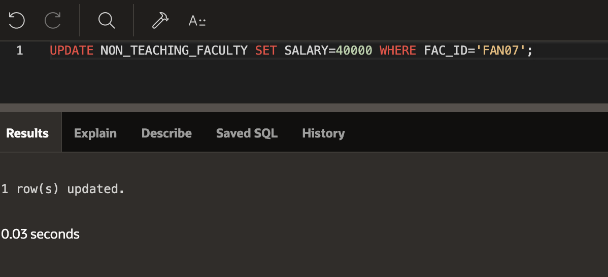
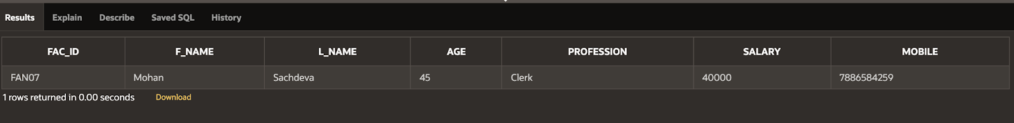
INSERT It is used to insert data into the row of a table. UPDATE This command is used to update or modify the value of a column in the table.
INSERTING ENTRIES(ROWS) INTO
NON_TEACHING_FACULTY TABLE ACCORDING TO ITS COLUMNS(FIELDS)

Slide 14
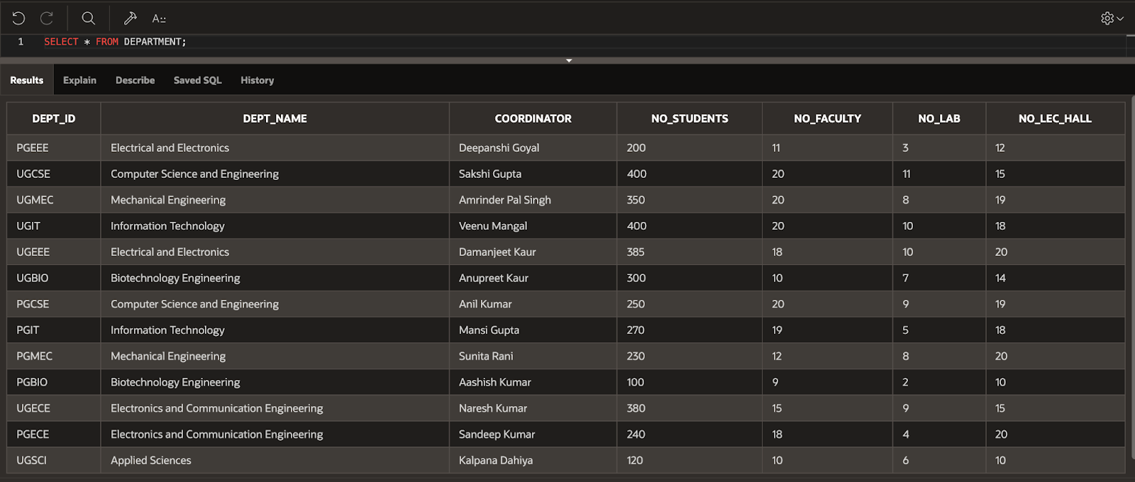
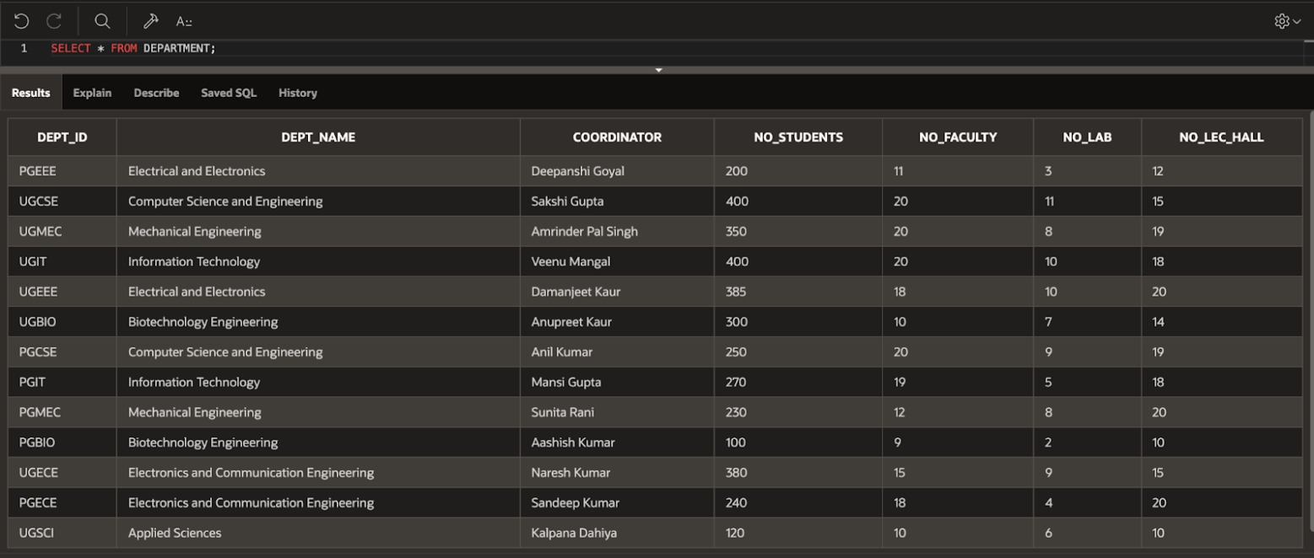
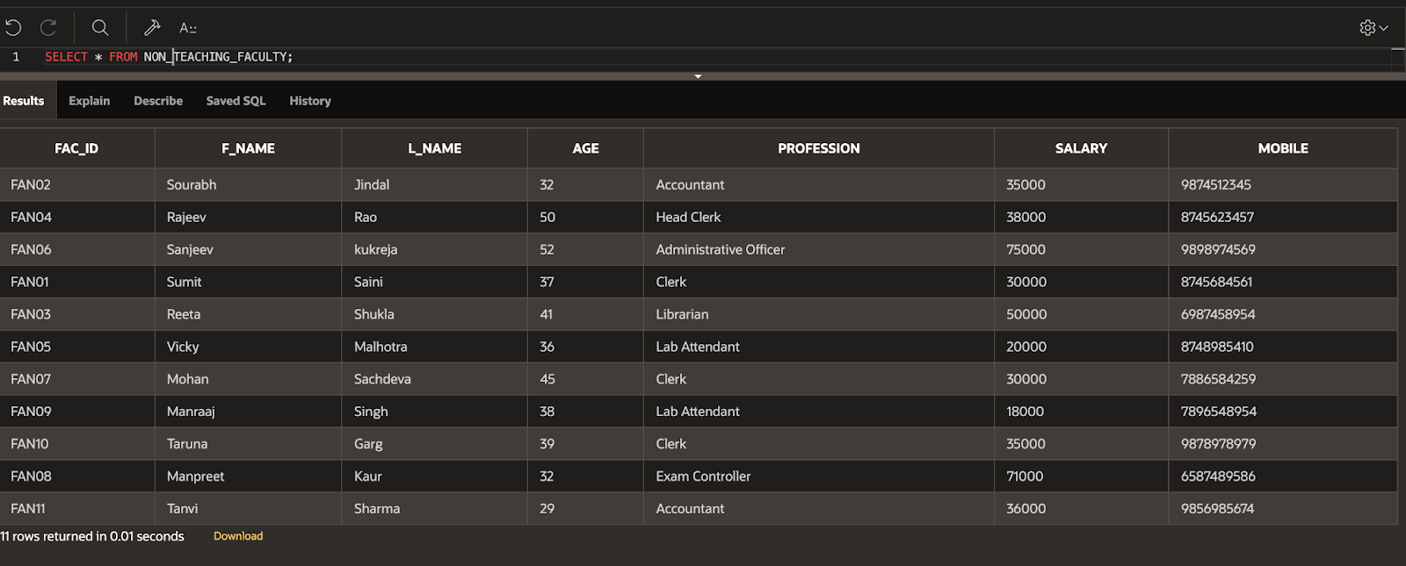
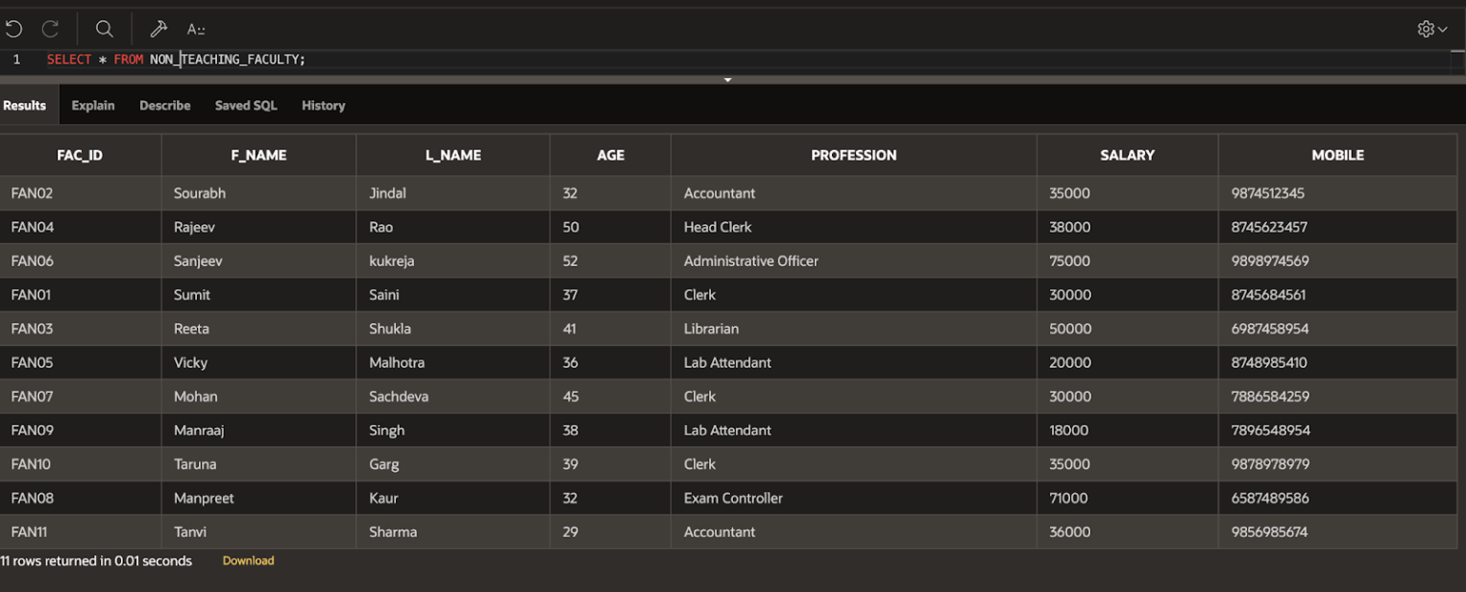
SELECT
It is used to fetch the data from a database table which returns this data in the form of a result table.
NOTE: THIS IS ONLY A PARTS OF ENTRIES OF TABLES
WHICH IS RETRIEVED USING SELECT COMMAND.

Slide 15
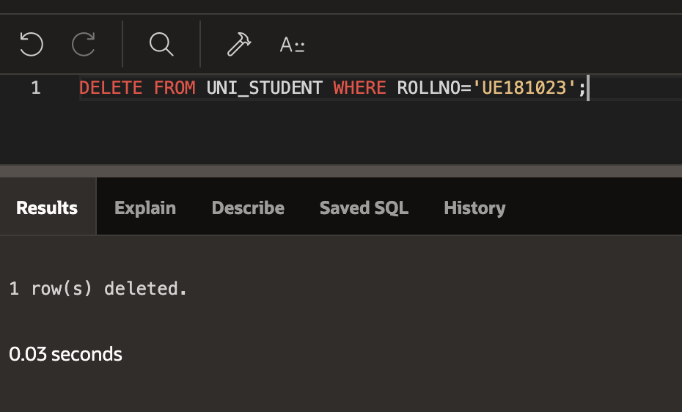
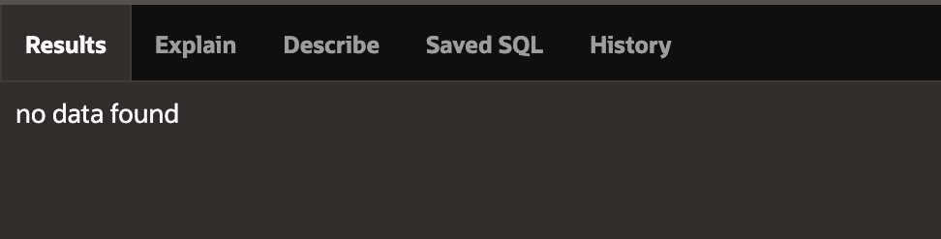
DELETE It is used to remove one or more row from a table.
DML is Data Manipulation Language which is used to manipulate data itself.
-DML INSTRUCTIONS
It add or update the row of the table. These rows are called as tuple.

Slide 16

CONSTRAINTS
AND
FUNCTIONS

Slide 17
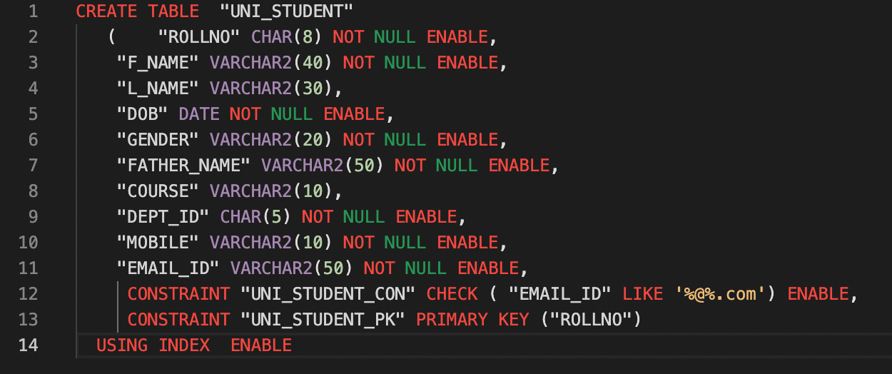
NOT NULL
Ensures that a column cannot have a NULL value
ENABLE
ENABLE Clause Specify ENABLE if you want the constraint to be applied to the data in table.
DISABLE
DISABLE Clause is used if you do not want to apply the constraint temporarily to the data in table.
UNIQUE
Ensures that all values in a column are different
PRIMARY KEY
A combination of a NOT NULL and UNIQUE. Uniquely identifies each row in a table
CHECK
Ensures that the values in a column satisfies a specific condition

Slide 18
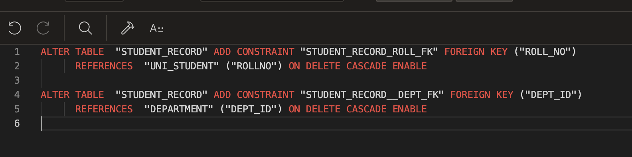
FOREIGN KEY
Prevents actions that would destroy links between tables
ON CASCADE DELETE
It specifies that the child data is deleted when the parent data is deleted.

Slide 19

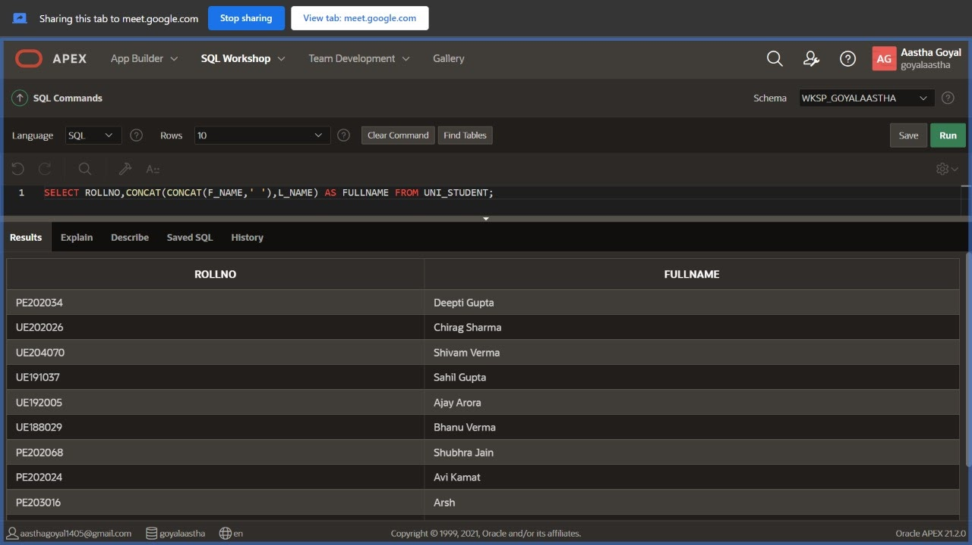
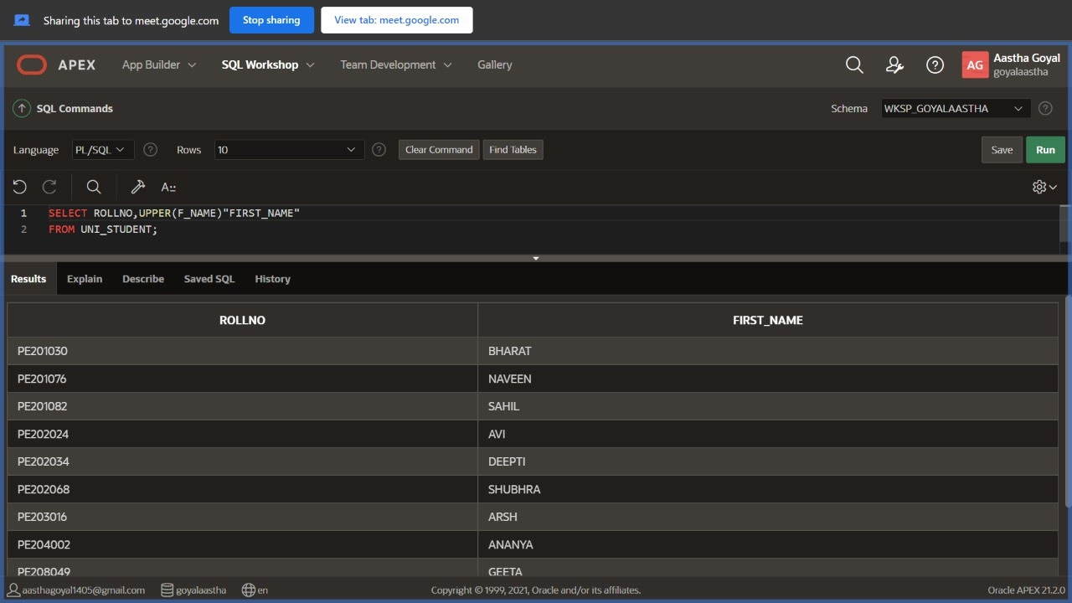
CONCAT()
This function
Adds two or more expression(s)
together.
UPPER() This function returns
the string of characters with all
characters in upper case.
LOWER() This function returns
the string of characters with all
characters in lower case.

Slide 20
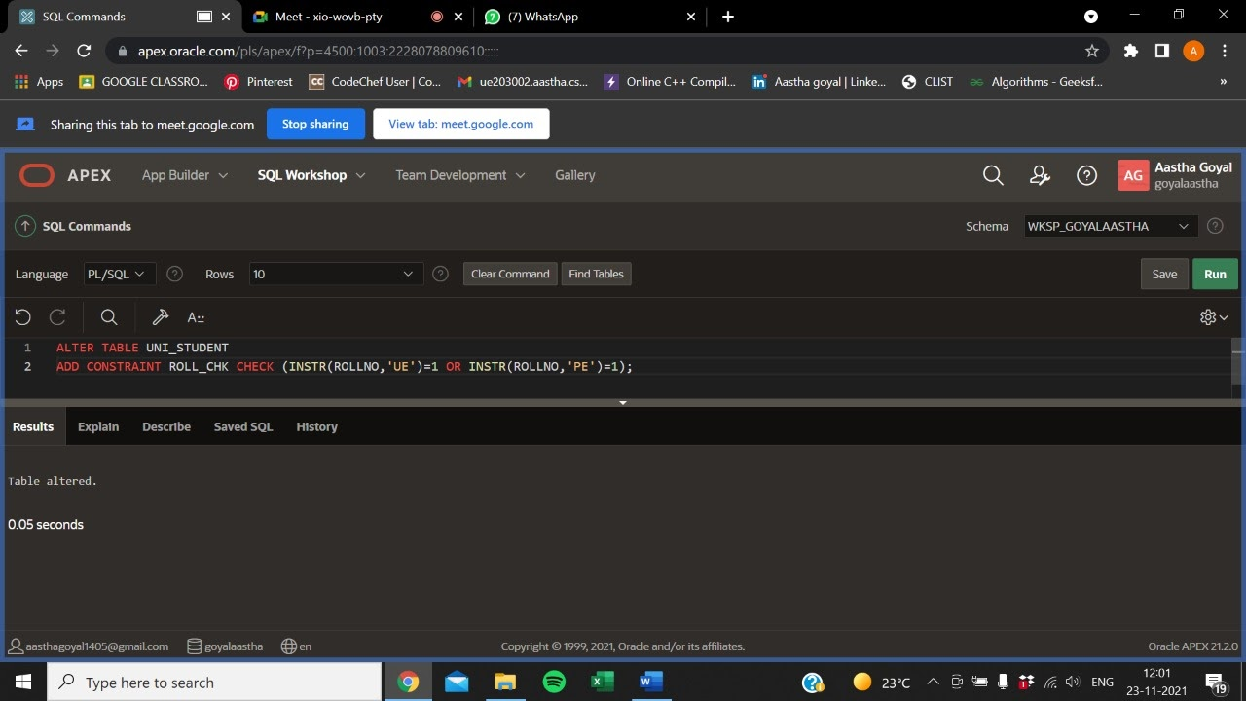
INSTR() This function searches a
character string subset and returns
the starting position of the substring.
STRING FUNCTIONS:
LENGTH() This function returns a numeric value equivalent to number of characters in the string.
LTRIM() This function is used to trim the specified characters from the left end of the string.
RTRIM() This function is used to trim the specified characters from the right end of the string.
SUBSTR() This function returns a string of specified characters from a larger character string beginning at a specified character position.

Slide 21
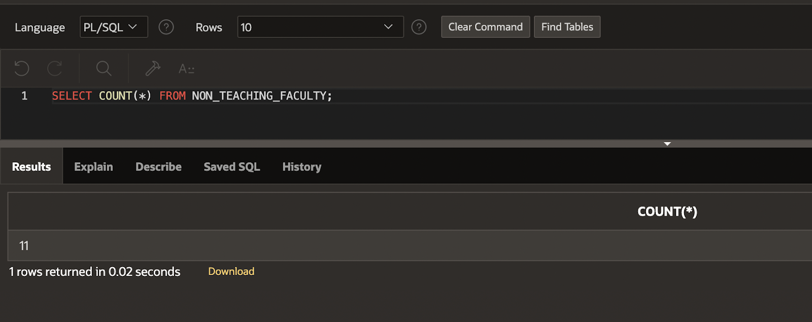
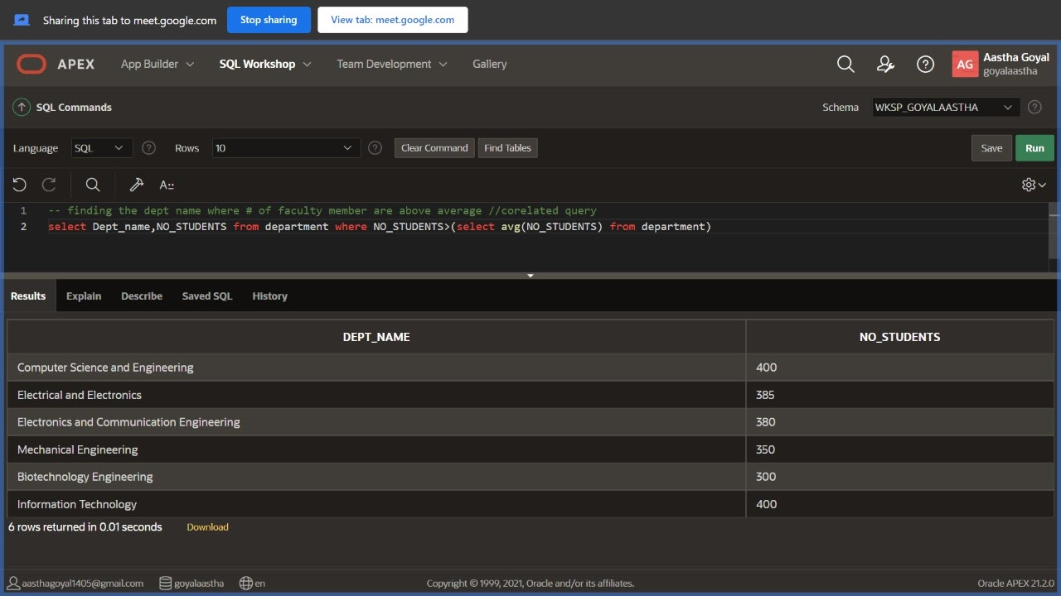
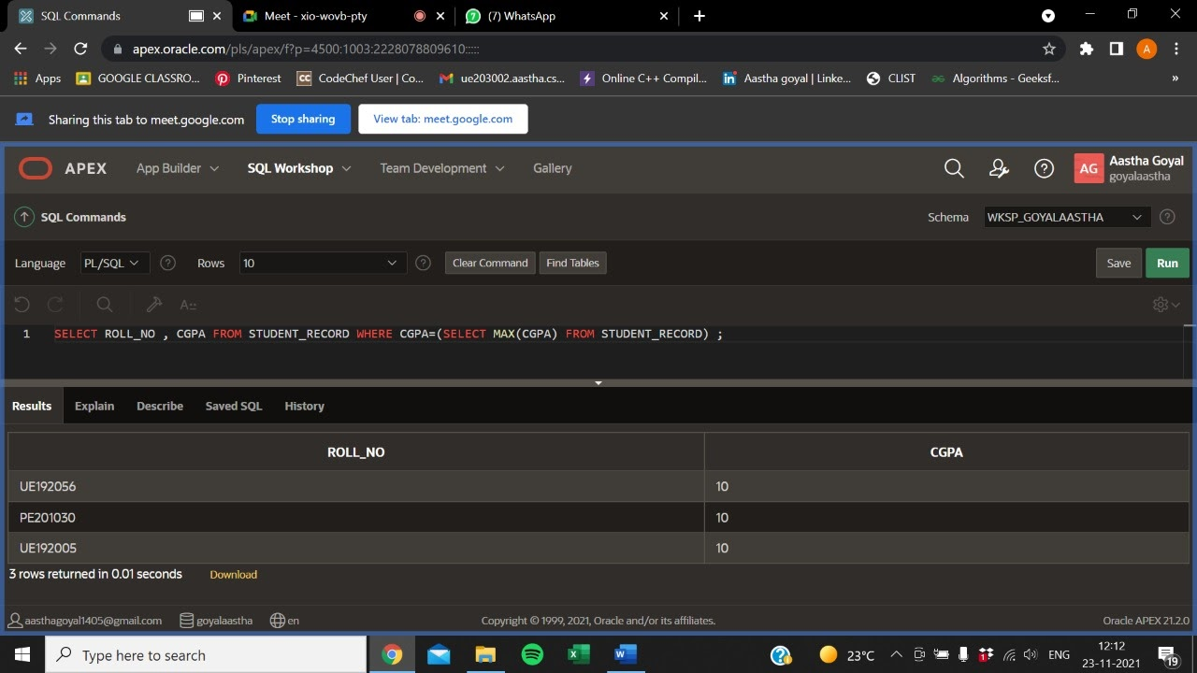
AGGREGATE FUNCTION
SUM( ): The SUM() function returns the sum of all the values of the selected column.
COUNT( ): It is used to count the number of rows returned in a SELECT statement.
AVG( ): It returns average value after calculating from values in a numeric column.
MIN( ): It returns the minimum value of the selected column.
MAX( ): It returns the maximum value of the selected column.

Slide 22
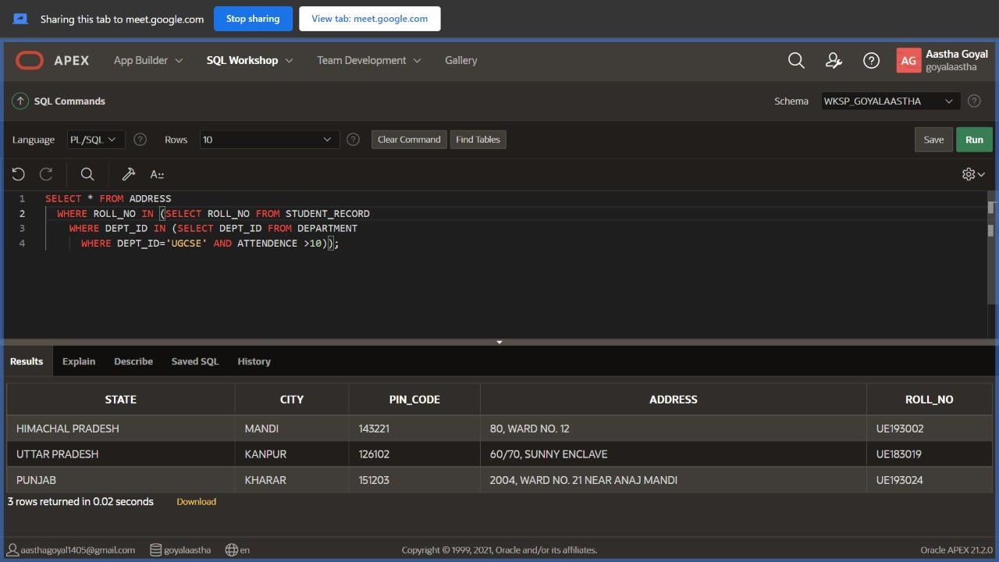
LOGICAL OPERATORS
AND : Logical AND compares between two Booleans as expressions and returns true when both expressions are true.
OR : Logical OR compares between two Booleans as an expression and returns true when one of the expressions is true.
NOT : Not takes a single Boolean as an argument and changes its value from false to true or from true to false.

Slide 23
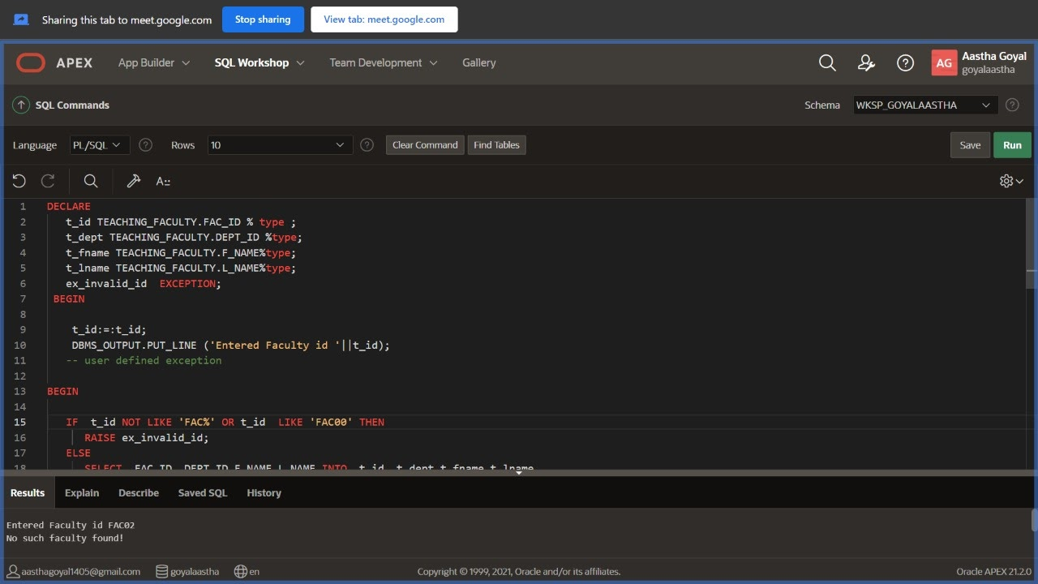
LOGICAL OPERATORS -CONTD.
OR LOGICAL OPERATOR
NOT LOGICAL OPERATOR
OR LOGICAL OPERATOR
LIKE OPERATOR

Slide 24
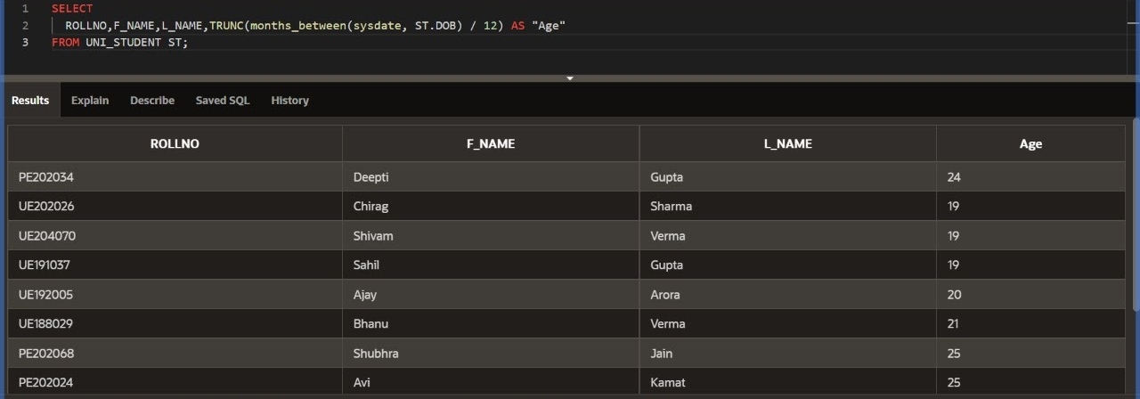
DATE FUNCTION Displays roll no, first name, last name and age of students by checking the difference between current date and DOB of students.

Slide 25

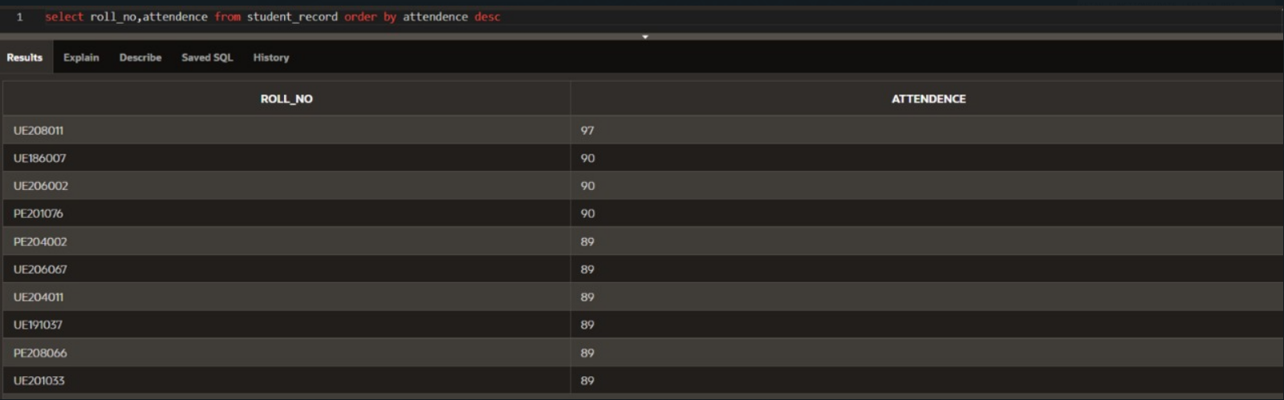
ORDER BY, GROUP BY, HAVING
ORDER BY It is used to sort the result-set in ascending or descending order.
GROUP BY It groups rows that have the same values into summary rows.
HAVING The HAVING clause was added to SQL because the WHERE keyword cannot be used with aggregate functions.

Slide 26
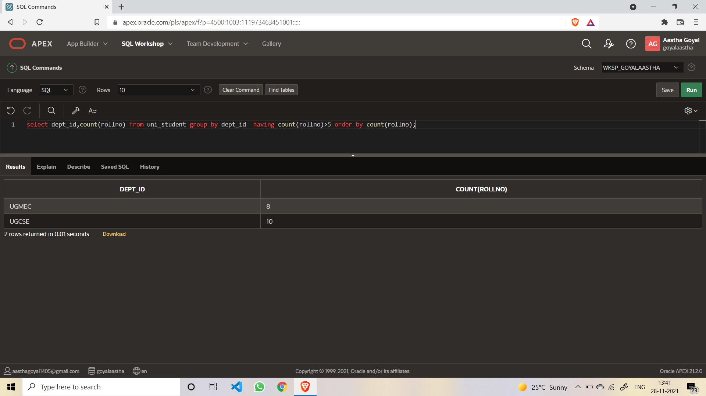
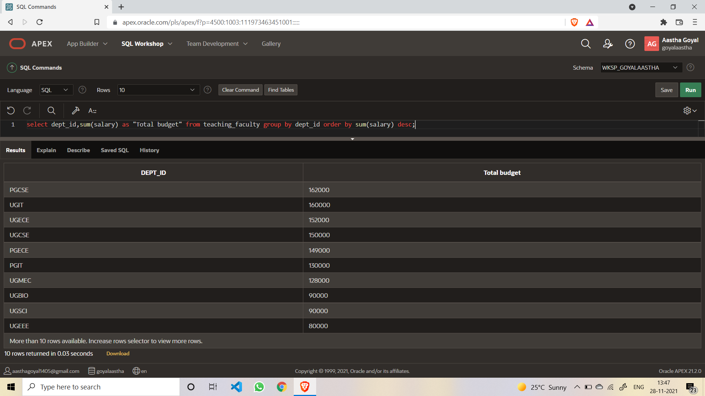

Slide 27
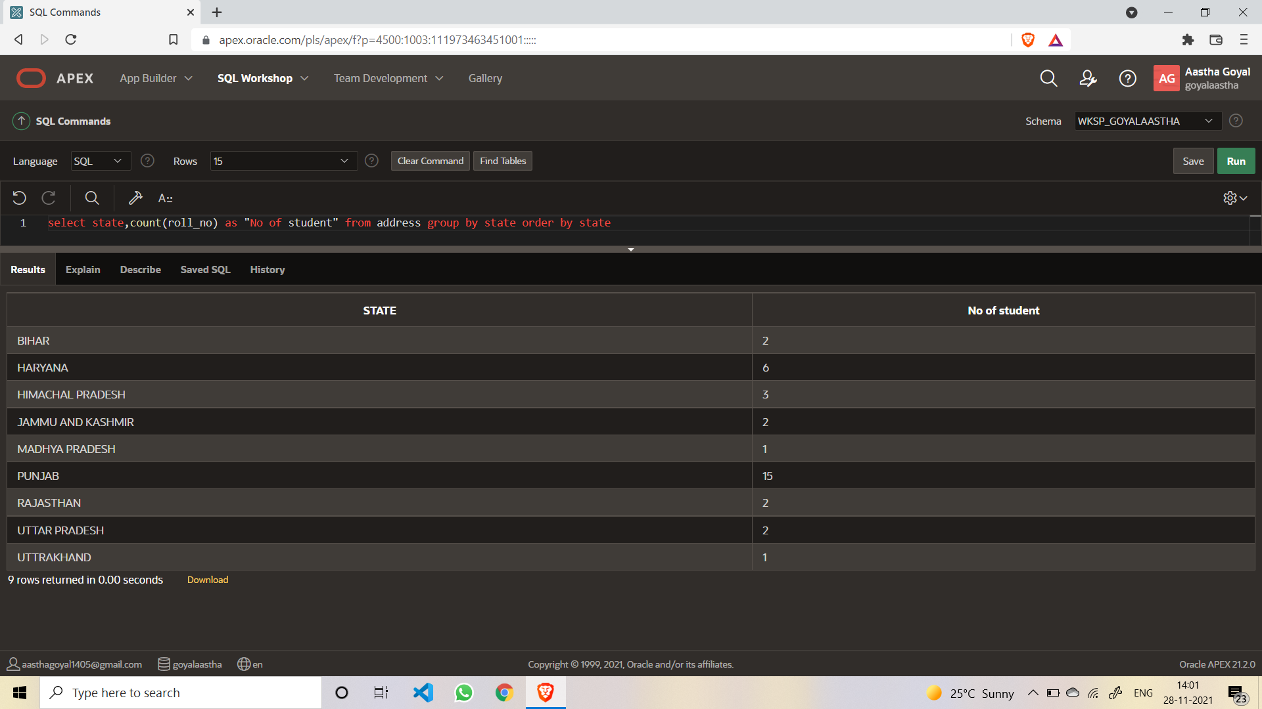
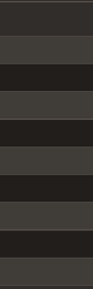
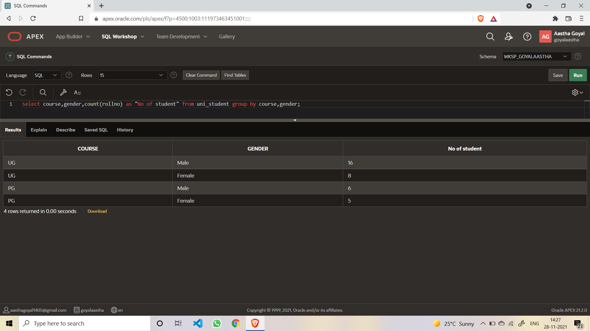

Slide 28
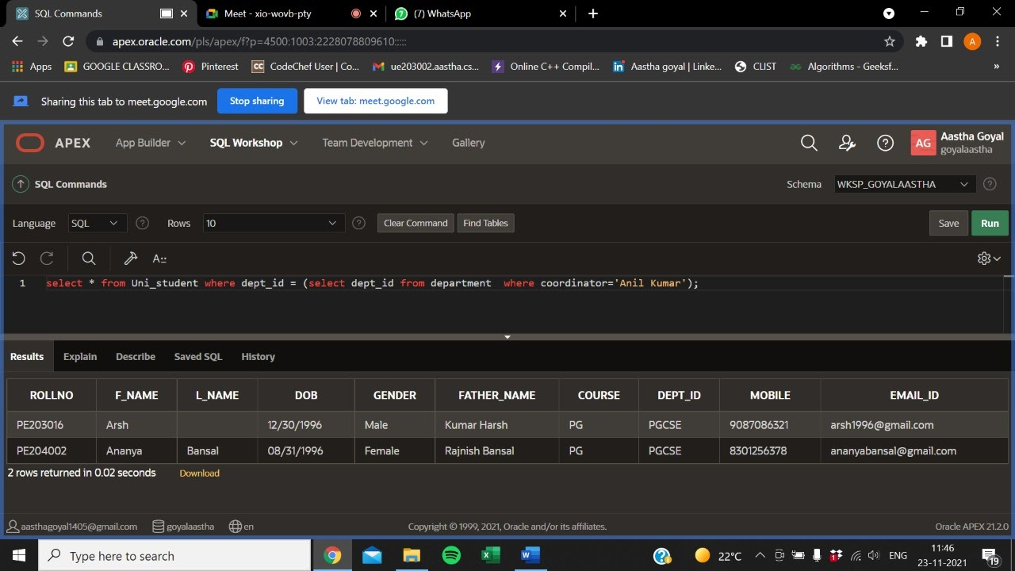
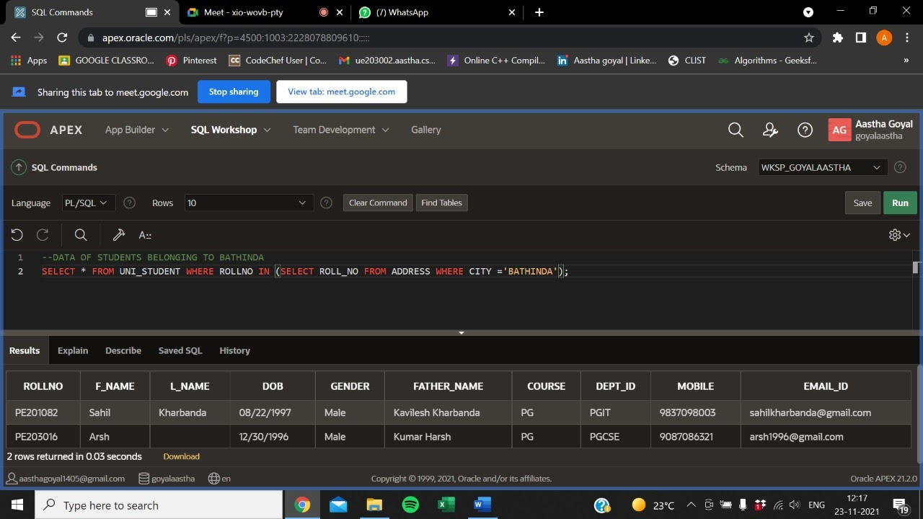
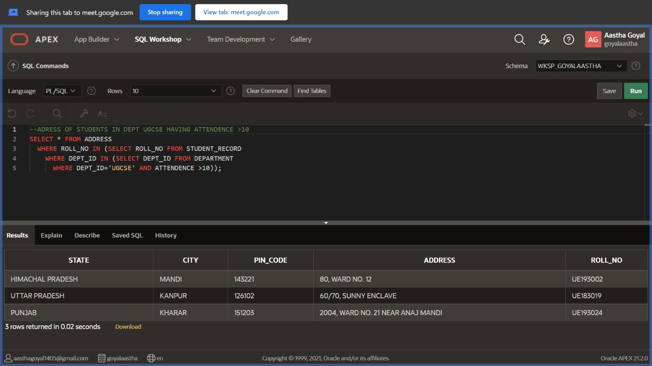
SUB-QUERIES

Slide 29
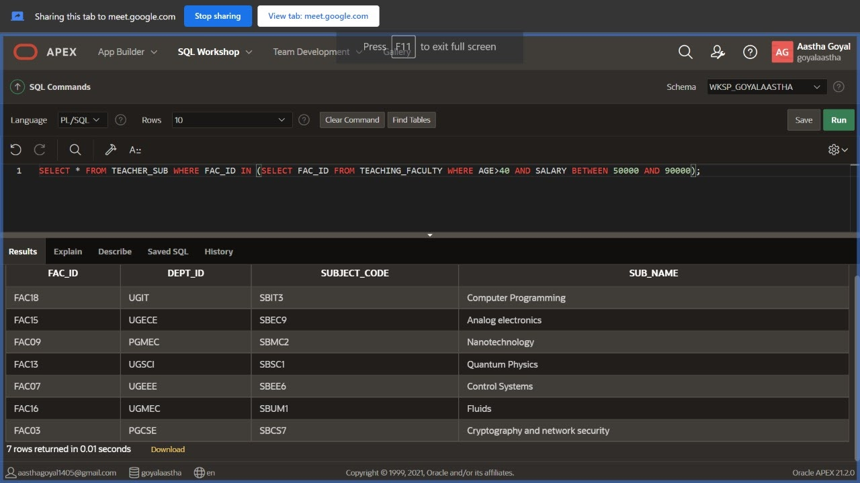
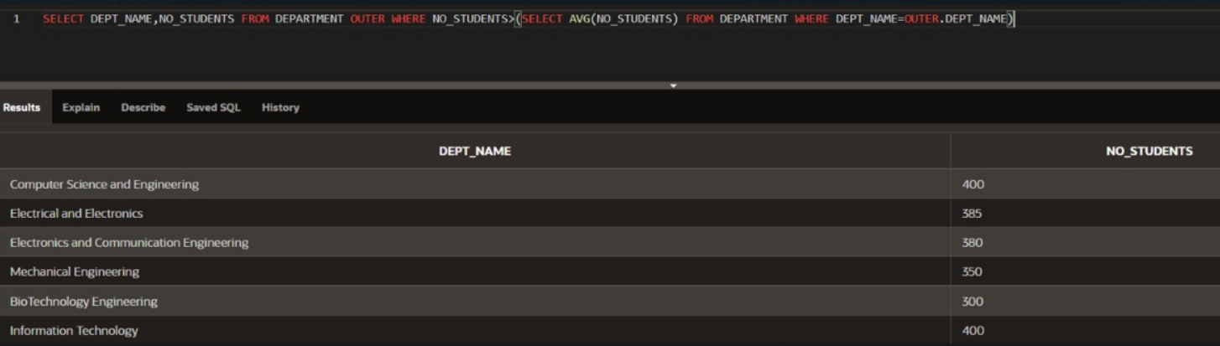

Slide 30
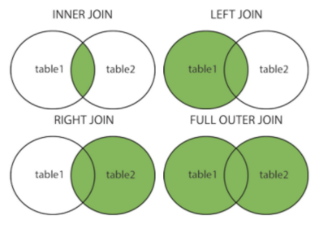
WHAT IF WE WANT TO WOrK ON MULTIPLE TABLES at one time ?
CAN’T WE COMBINE TWO OR MORE TABLES AND RUN QUERIES WITH A JOINED MANNER
In DBMS, a join statement is mainly used to combine two tables based on a specified common field between them. If we talk in terms of Relational algebra, it is the cartesian product of two tables followed by the selection operation.

Slide 31
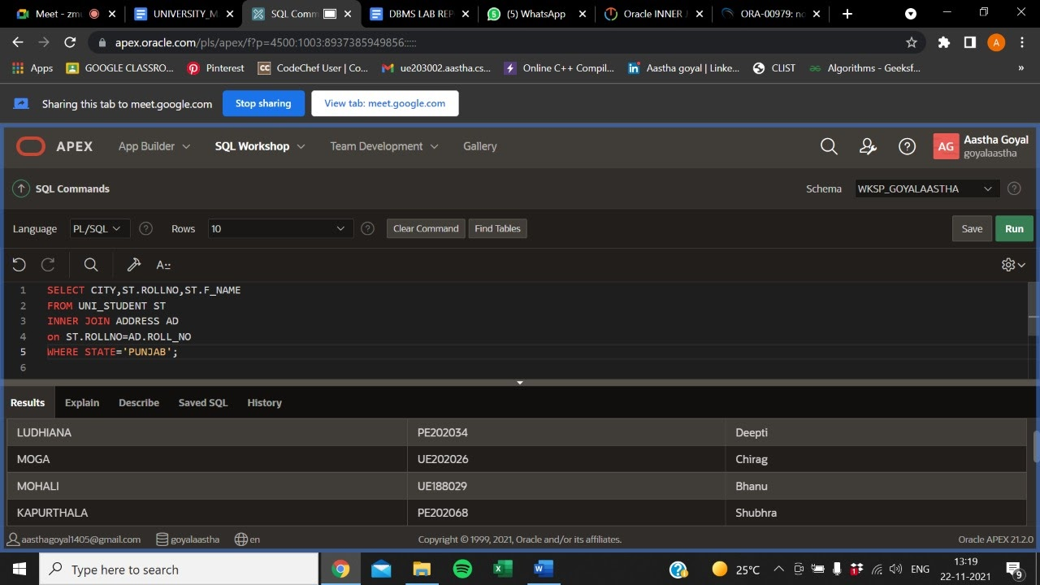
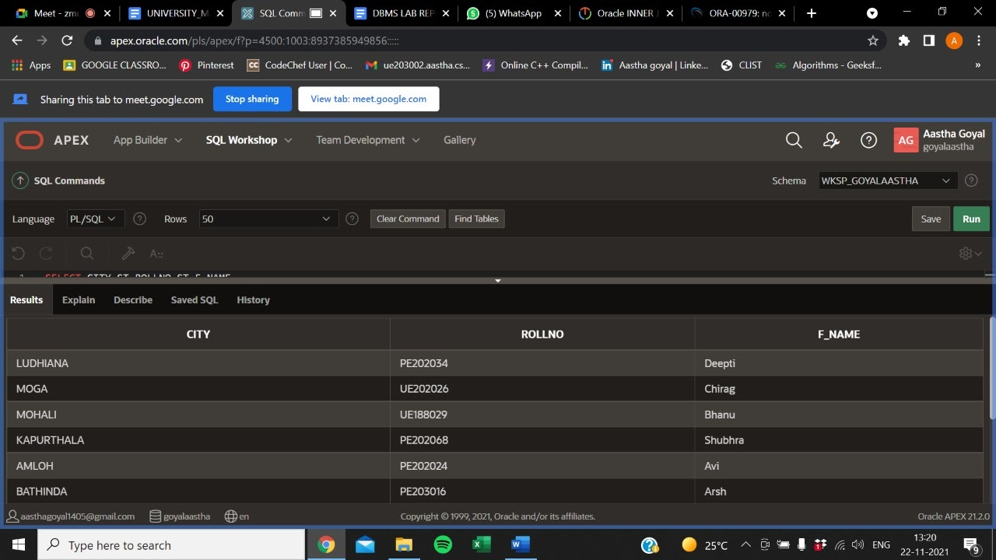
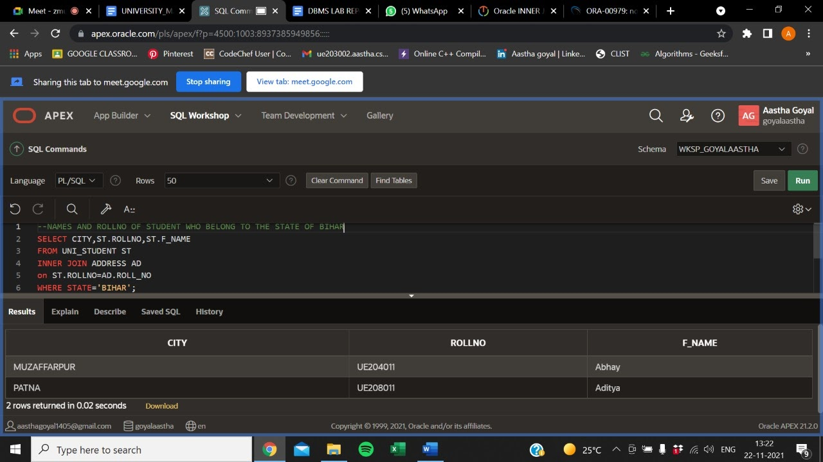
joins

Slide 32
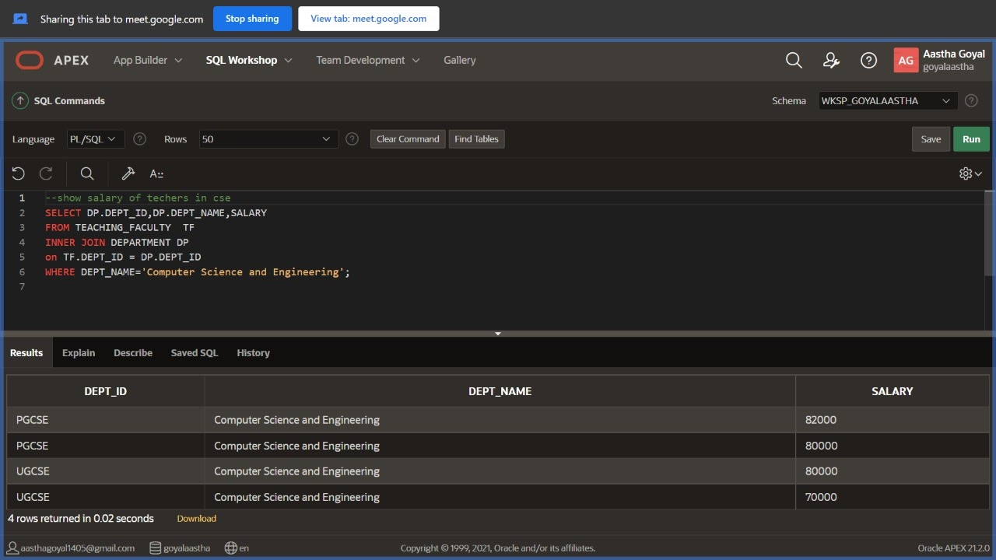
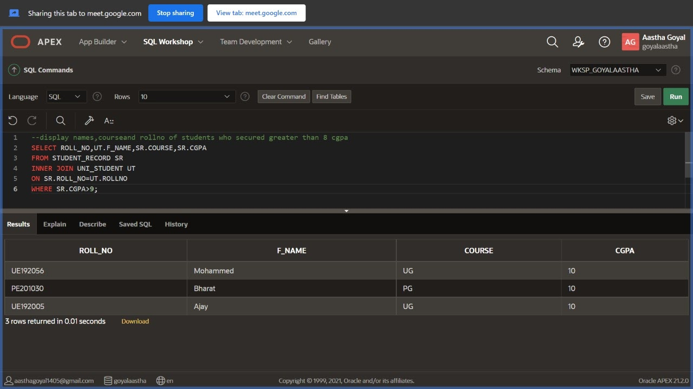
joins

Slide 33
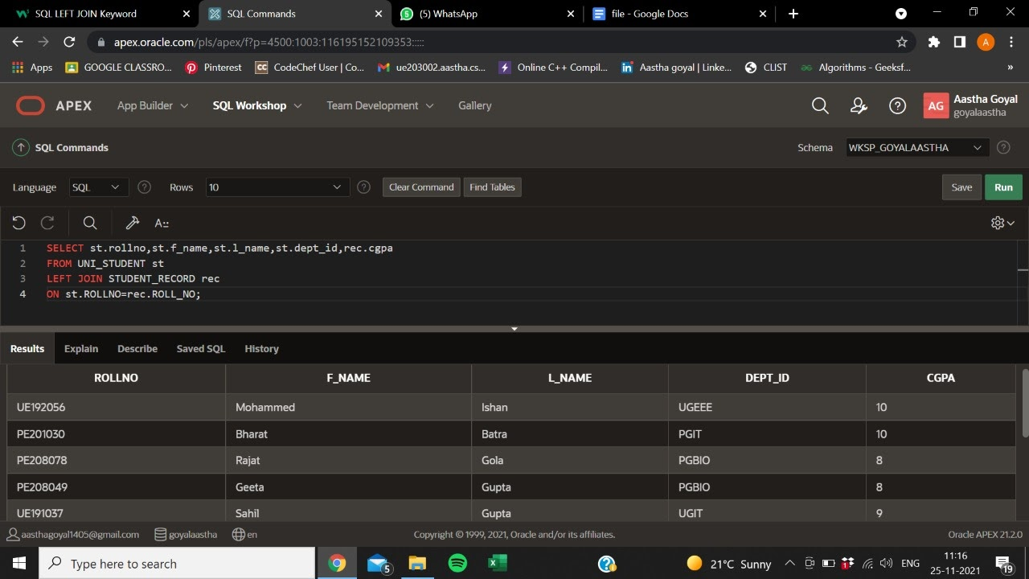
Left join

Slide 34
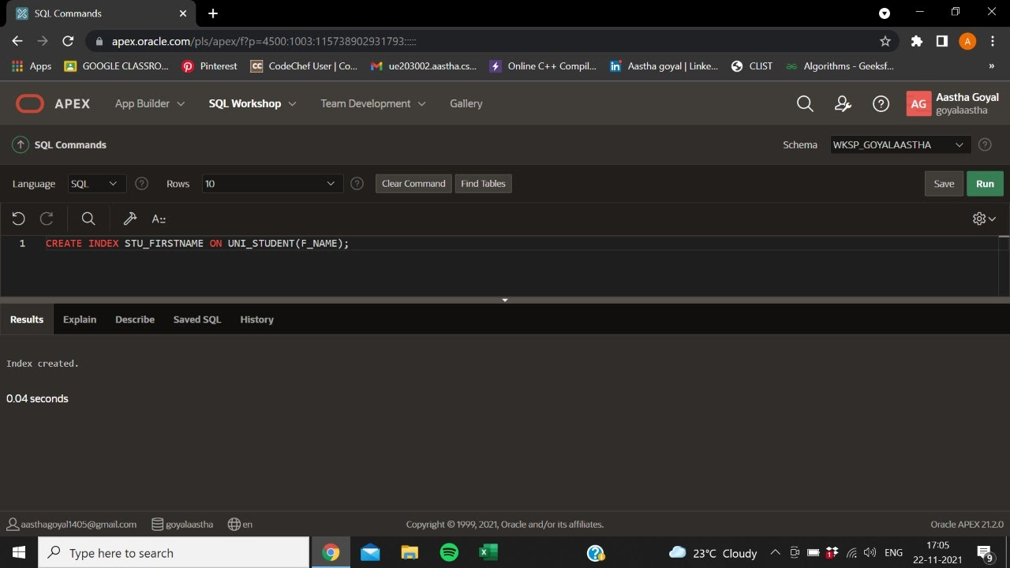
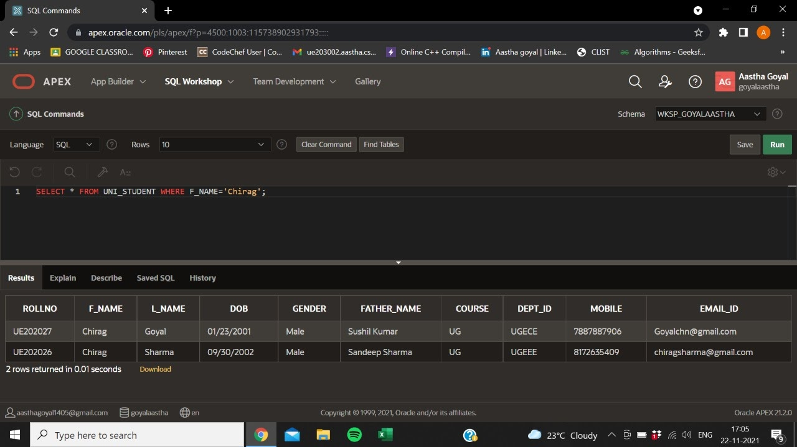
INDEXING
Indexes are special lookup tables that the database search engine can use to speed up data retrieval
An index helps to speed up SELECT queries and WHERE clauses, but it slows down data input, with the UPDATE and the INSERT statements. Indexes can be created or dropped with no effect on the data.

Slide 35




Slide 36




Slide 37



Slide 38


Slide 39


Slide 40


Slide 41


Slide 42


Slide 43


Slide 44


Slide 45


Slide 46


Slide 47


Slide 48

SEQUENCES
Sequence is a set of integers 1, 2, 3, … that are generated and supported by some database systems to produce unique values on demand.
A sequence is a user defined schema bound object that generates a sequence of numeric values.
Sequences are frequently used in many databases because many applications require each row in a table to contain a unique value and sequences provides an easy way to generate them.
The sequence of numeric values is generated in an ascending or descending order at defined intervals and can be configured to restart when exceeds max_value.

Slide 49



Slide 50



Slide 51

PLSQL
WHY WE SHOULD WRITE OUR CODES REPEATEDLY IN A SINGLE PROGRAM
PL/SQL is a combination of SQL along with the procedural features of programming languages.
A subprogram created inside a package is a packaged subprogram. It is stored in the database and can be deleted only when the package is deleted with the DROP PACKAGE statement.PL/SQL subprograms are named PL/SQL blocks that can be invoked with a set of parameters.
PL/SQL provides two kinds of subprograms −
Functions − These subprograms return a single value; mainly used to compute and return a value.
Procedures − These subprograms do not return a value directly; mainly used to perform an action.

Slide 52

TRIGGERS
Before event
Triggers
Triggers are stored programs, which are automatically executed or fired when some events occur. The triggers are executed in response to certain events (INSERT, UPDATE or DELETE) in a particular table. These triggers help in maintaining the integrity of the data by changing the data of the database in a systematic fashion.
Types of Triggers
Before event Triggers
After event Triggers
Row Trigger
Statement trigger

Slide 53



DELETION:
UPDATION:
INSERTION:

Slide 54



STATEMENT LEVEL BEFORE EVENT TRIGGER
AFTER EVENT TRIGGER
ROW LEVEL TRIGGER:

Slide 55

CURSOR
Cursor is a Temporary Memory or Temporary Work Station. It is Allocated by Database Server at the Time of Performing DML(Data Manipulation Language) operations on Table by User. Cursors are used to store Database Tables.
There are 2 types of Cursors:-
Implicit Cursors: Implicit Cursors are also known as Default Cursors of SQL SERVER. These Cursors are allocated by SQL SERVER when the user performs DML operations.
Explicit Cursors :Explicit Cursors are Created by Users whenever the user requires them. Explicit Cursors are used for Fetching data from Table in Row-By-Row Manner.
implicit cursor with attributes
%found, %notfound, %rowcount

Slide 56


An explicit cursor is a named pointer to a private SQL area that stores information for processing a specific query or DML statement—typically, one that returns or affects multiple rows. Here the named pointer is "c_student" which fetches data of first name,last name and gender into c_f_name,c_l_name and c_gender attribute %notfound checks the availability of data that c_student fetches

Slide 57
EXCEPTION HANDLING
An exception is an error which disrupts the normal flow of program instructions. PL/SQL provides us the exception block which raises the exception thus helping the programmer to find out the fault and resolve it.
There are two types of exceptions defined in PL/SQL
SYSTEM DEFINED EXCEPTIONS:
These exceptions are predefined in PL/SQL which get raised WHEN certain database rules are violated.
USER DEFINED EXCEPTIONS:
This type of users can create their own exceptions according to the need and to raise these exceptions explicitly raise command is used.

Slide 58


EXCEPTION HANDLING functionality
SYSTEM DEFINED
DATA PRESENT
DATA NOT PRESENT SO EXCEPTION THROWN

Slide 59



EXCEPTION THROWN
EXCEPTION HANDLING
USER DEFINED

Slide 60




DATA FOUND
EXCEPTION THROWN

Slide 61

PACKAGES:
Packages are schema objects that groups logically related
PL/SQL types, variables, and subprograms.
A package will have two mandatory parts −
Package Body
The package body has the codes for various methods declared in the package specification and other private declarations, which are hidden from the code outside the package.
Package Specification
The specification is the interface to the package. It just DECLARES the types, variables, constants, exceptions, cursors, and subprograms that can be referenced from outside the package.

Slide 62

Containing 3 procedures:
To delete a row from table non_teaching_faculty.
To add a row into the table non_teaching_faculty.
To categorize the employees into certain classes on the basis of salary belonging to the table non_teaching_faculty.

Slide 63



Slide 64



Slide 65



Slide 66


